Slide 1
911 Emergency Calls Analysis – Insights and Suggestions
- Narayani Gupta

Slide 2
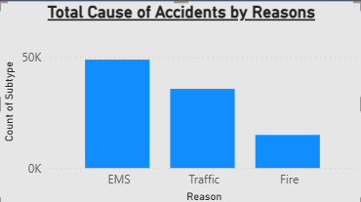

Accidents and Cause Of it

Slide 3
Accidents and Cause of it
EMS calls are the majority, followed by Traffic and Fire.
Most common subtypes: Vehicle accidents, cardiac emergencies,
and fire alarms.
Indicates high need for medical response & road safety measures.

Slide 4
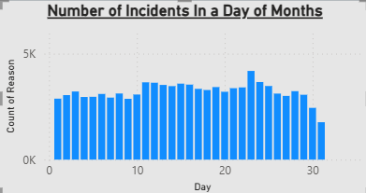
Day Wise Incidents
More incidents happen on weekdays (Mon–Fri).
Thursday & Friday are the most busy days.
Suggests extra staffing needed during work week traffic & office rush.

Slide 5
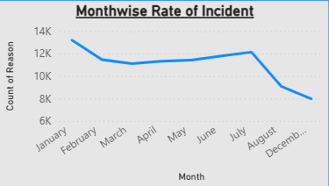
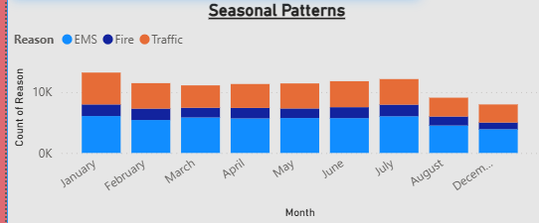
Month wise Incidents

Slide 6
Month Wise Incidents
Certain months show higher emergencies.
Shows seasonal patterns in incidents.
Seasonal readiness like fire safety drills, winter driving awareness is needed.

Slide 7
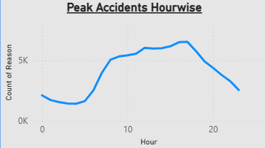
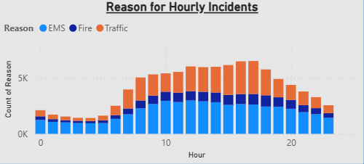
Hour wise Incidents

Slide 8
Hour wise Incidents
Calls peak at morning (7–9 AM) and evening (4–7 PM) rush hours.
Late night calls are fewer but have serious EMS cases.
Staff & ambulances should be pre-positioned at rush hours.

Slide 9
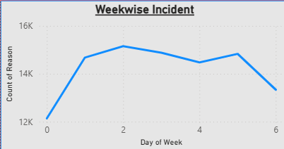
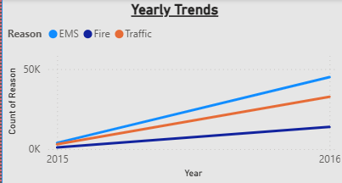
Week and Yearly Pattern

Slide 10
Week and Yearly Pattern
Emergencies are rising over time, especially Traffic & EMS.
Weekdays are consistently higher than weekends.
Indicates growing demand for emergency services and better long-term planning.

Slide 11
Conclusion
Peak Hours are morning and evening emergency staff should be pre-positioned.
Need better road safety measures.
In Seasonal period needs more Pre-Preparation to reduce the accidents.
Also more preparation is required in the Working days Monday to Friday as more people can have accidents during the peak hours.
Run Fire-safety workshops in high-risk months.
Enhance Healthcare readiness for EMS related emergencies.

Slide 12
Suggestions
Increase emergency response staff during peak hours.
Place ambulances/fire units closer to hotspot areas.
Improve traffic management & awareness campaigns.
Run fire safety workshops in high-risk months.
Enhance healthcare readiness for EMS-related emergencies.

